Slide 1
SOFTWARE ENGINEERING
Socio-technical systems

Slide 2
SYSTEMS
Software Engineering is not an isolated activity but is part of a broader systems engineering process.
Software system are not isolated and are essential components.

Slide 3
System/Complex System ?
“A system is a purposeful collection of interrelated components that work together to achieve some objective”
System that includes s/w fall into two categories
– Technical computer-based systems
Systems that includes hardware and software components but not procedures and processes.
– Socio-technical systems
●
Systems that include technical systems but also operational processes and people who use and interact with the technical system. Socio- technical systems are governed by organisational policies and rules.
●

Slide 4



Technical Computer-based Systems
System that include hardware and software but where the operators and operational processes not normally considered to be part of the system.

Slide 5
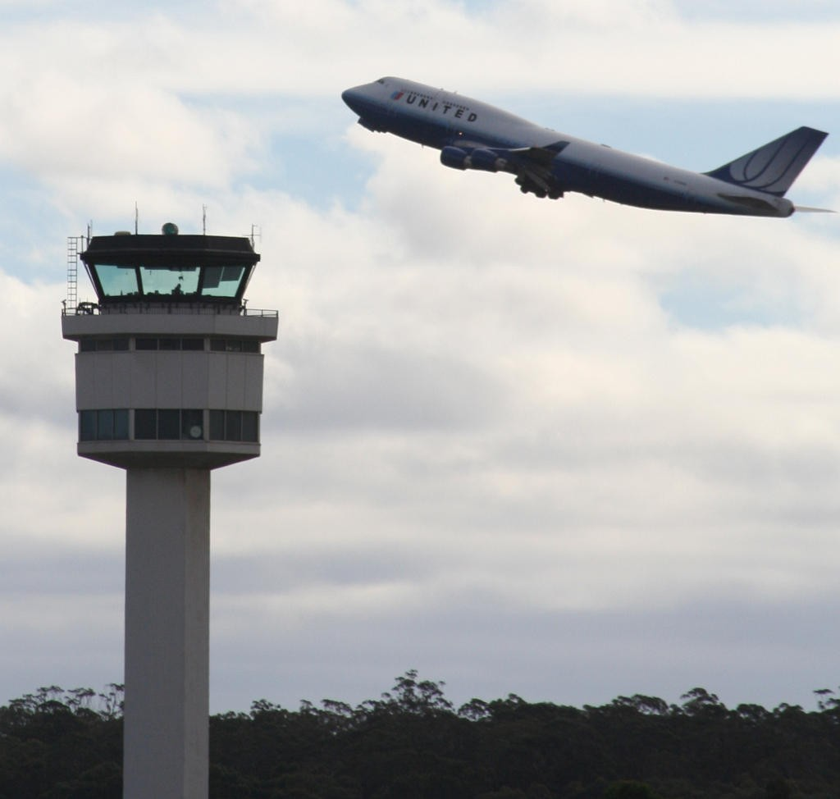


Socio-technical System
System that include technical systems but also operational processes and people who use and interact with the technical system.
Socio-technical systems are governed by organizational policies and rules.

Slide 6
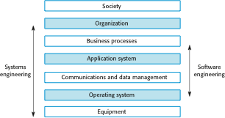
Sociotechnical System Stack

Slide 7
Layers in the STS stacks
Equipment
Hardware devices , some of which may be computers.Most devices will include an embedded system of some kind.
Operating System
Provides a set of common facilities for higher levels in the system.
Communications and data management
Middleware that provides access to remote systems and databases.
Application systems
Specific functionality to meet some organization requirements
●
●
●
●

Slide 8
Layers in the STS stacks
Business processes
A set of processes involving people and computer systems that support the activities of the business
Organizations
Higher level strategic business activities that affect the operation of the system.
Society
Laws , regulation and culture that affect the operation of the system.
●
●
●

Slide 9
Holistic System Design
There are interactions and dependencies between the layers in a system and changes atone level ripple through the other levels.
– Change is regulation leads to changes in business processes and application software

Slide 10
Organizational Affects
Process Changes
Significant changes may be resisted by users.
Job Changes
System me de-skill user or cause changes to the way they work.
Organizational Changes
May change political power structure in an organization.
●
●
●

Slide 11
Socio-technical system characteristics
Emergent Properties
Properties of the system of a whole that depend on the system components and their relationships
Non-deterministic
They do not always produce the same output when presented with the same input because the system’s behaviour is partially dependent on human operators.
Complex relationships with organizational objective
The extent to which the systemm supports organizational objective does not just depend on the system itself.
●
●
●

Slide 12
Emergent Properties
Property | Description
Volume | The volume of a system (the total space occupied) varies depending on how the component assemblies are arranged and connected.
Reliability | System reliability depends on component reliability but unexpected interactions can cause new types of failures and therefore affect the reliability of the system.
Security | The security of the system (its ability to resist attack) is a complex property that cannot be easily measured. Attacks may be devised that were not anticipated by the system designers and so may defeat built-in safeguards.
Repairability | This property reflects how easy it is to fix a problem with the system once it has been discovered. It depends on being able to diagnose the problem, access the components that are faulty, and modify or replace these components.
Usability | This property reflects how easy it is to use the system. It depends on the technical system components, its operators, and its operating environment.

Slide 13
Types of Emergent Property
Functional Properties
These appear when all the parts of a system work together to achieve some objective
Non-functional emergent properties
Example are reliability , performance , safely and security.These relate to the behaviour of the system in its operational environment
●
●

Slide 14
Reliability as an emergent property
●
Because of component inter-dependencies faults can be propogated through the system
System failure often occur because of unforeseen inter-relationships between components
Consider reliability from three prospectives:-
Hardware reliability
Software reliability
Operator reliability
●
●

Slide 15
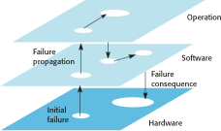
Failure Propagation

Slide 16
Non-determinism
People are non-deterministics
Sociotechnical systems are non-deterministic partly because of :-
People
Changes to h/w , s/w and data in these systems are so frequent.
●
●

Slide 17
System Engineering
So , system engineering involved following activities :-
Procuring
Specifying
Designing
Implementing
Validating
Deploying
Operating
and , maintaining

Slide 18
Stages of Systems Engineering
There are three overlapping stages in the lifetime of large and complex sociotechnical systems :-
Procurement or Acquisition
Development
Operation
●

Slide 19
Procurement or Acquisition
It includes :-
Purpose of system is decided
High-level system requirements are established
Decision are made on how functionality will be distributed across hardware , software and people
and ,components that will make up the system are purchased
●

Slide 20
Development
It includes :-
– development activities related to
●
●
System Developments (requirements definition , system design , hardware and software engineering , system integration and testing)
operational Processes are defined
the training courses for system users are designed.
●
●

Slide 21
Operation
It includes :-
System is deployed
Users are trainined
System is brought into use
●

Slide 22
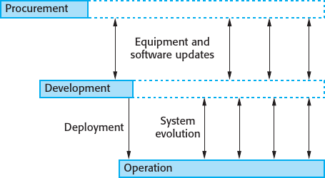
Stages of System Engineering

Slide 23
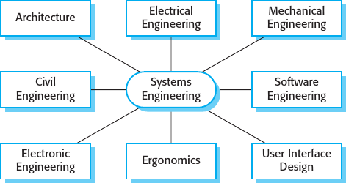
Air Traffic Management System

Slide 24
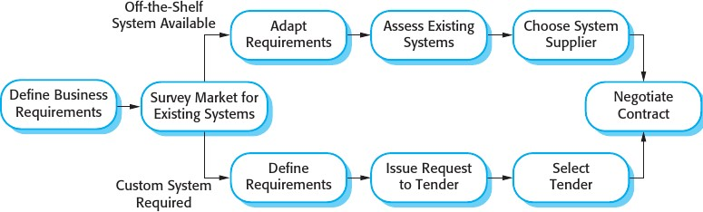
System Procurement
●
System Procurement Process

Slide 25
System Development
Goal of System Development Process :-
Develop or acquire all of the components of a system
Integrate these components to create the final system
Fundamental activities involved in system development
Requirements Development
System Design
Subsystem Engineering
System Integration
System Testing
System Development

Slide 26
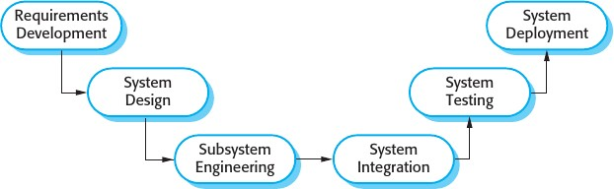
System Development

Slide 27
System Development
Requirement Development
High-level and business requirements identified during the procurement process have to be developed in more detail.
System Design
This process overlap with requirement development process
Establishing the overall architecture of the system
Identifying different components and understanding relationship between them

Slide 28
System Development
Subsystem Engineering
It involves development of system components
Configuring off-the-self hardware and software
If necessary , design special-purpose hardware
Define operational processes for the system
Redesign essential business processes
System Integration
The components are put together to create a new system

Slide 29
System Development
System Testing
Its an extensive process which contains activities to identify the problem
If found fault then Rreentered into subsystem engineering and system integration phase.
Testing can be done by :
System Developers
Acceptance/User of the organization
●
●
System Deployment
– Transferring data from existing systems , and establishing communications with other systems in the environment

Slide 30
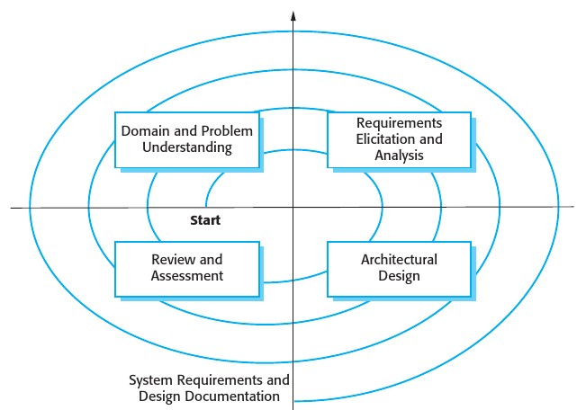
New Requirements Emerge
Requirements affect design decisions and vice versa
Spiral Model

Slide 31
Integrate subsystem
Integration of subsystem can be done using :-
“Big-Bang” approach
Incremental approach
Development of subsystem can be finished at the same time.
Incremental integration reduces the cost of error location.
Now a days systems developed using COTS (component off-the-self) h/w and s/w.

